Slide 1
How hard is it to buy a house in Singapore?
Ft. Couple Edition
By Ashley Bai [P2237871]

Slide 2
SINGAPORE HOUSING DATASET
Field Name | Description | Data Type
Year | YYYY | Date
Town | Towns in Singapore | Text
Flat_type | '1 ROOM', '2 ROOM', '3 ROOM', '4 ROOM', '5 ROOM', 'EXECUTIVE' | Text
Latitude | Latitude coordinate of the HDB block, mostly between 1.27-1.46 | Coordinates
Longitude | Longitude coordinate of the HDB block, mostly between 103.5-104.0 | Coordinates
Area_sqm | Size of the flat in square metres | Integer
Flat_model | 'New Generation', 'Improved', 'Standard', 'Model A', 'Apartment', 'Maisonette', 'Model A-Maisonette', 'Simplified', 'Terrace', 'Improved-Maisonette', 'MULTI GENERATION', 'Premium Apartment', 'Multi Generation', 'Adjoined flat', 'Premium Maisonette', '2-room', 'Model A2' | Text
Lease_start | Year in which the 99-year lease commenced. | Integer
Lease_rem | The number of years of remaining lease, as calculated from 2021-lease_start | Integer
Resale_price | The agreed transaction price in nominal S$ of the house, excluding stamp duties and other agent fees | Integer
price _psm | The price per square metre as calculated from resale_price/area_sqm | Integer
Core CPI | Inflation rate | Integer
Price Psm KPI | Check if flat falls within Price Psm budget of $4000 | Integer
Resale Price KPI | Check if flat falls within resale price budget of $350,000 | Integer

Slide 3
Hi! I am Tom, a first year property agent.
I am currently serving a pair of Singaporean newlyweds, who also own a dog.
They have asked for my help in providing useful information on Singapore’s housing market, and
eventually help them find their forever home
in Singapore!

Slide 4
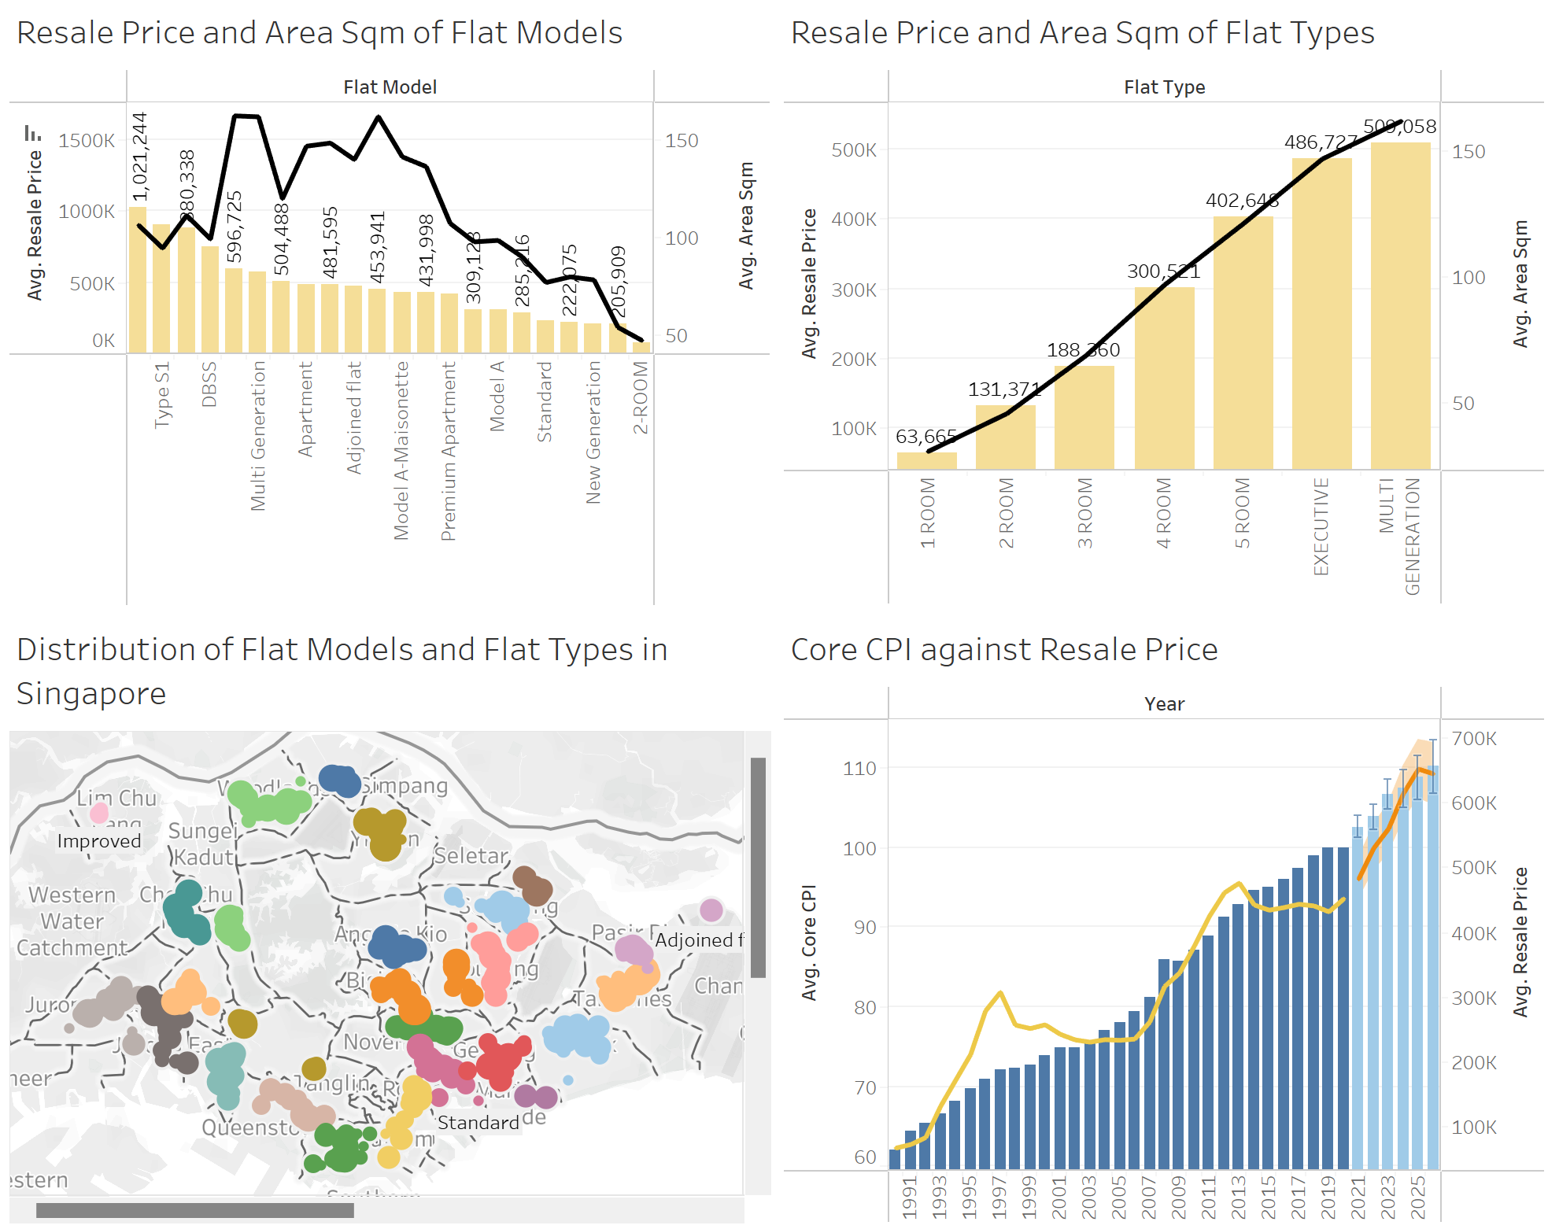
DB 1: singapore’s housing MARKET

Slide 5
DB 1: singapore’s housing MARKET
What is the distribution of flats in singapore?
The effect of core cpi on resale prices
The map shows the various flat types and flat models scattered around towns of Singapore, where a greater population of flats are concentrated in the Central and East regions of Singapore.
In addition, flat models (Adjoined, Improved and Model A) and flat types (3-5 Bedrooms) are largely prevalent in Singapore as compared to other flat models and types.
The bar graph represents the average Core CPI, while the line chart represents the average resale price of flats.
Despite the slight fluctuations, it is seen that
as Core CPI increases, the resale price of flats will also increases.
Furthermore, the forecast indicates that this trend will continue even after the year 2021 until 2026.

Slide 6
DB 1: singapore’s housing MARKET
the avg resale price and Area sqm of different flat models
The avg resale price and price psm depending on flat types
The bar graph represents the average resale price, while the line chart represents the average size of the flat in square metres, depending on the model of the flat.
It is evident that Type S2 flats have the largest average resale price of $1,021,244, while New Generation flats have the smallest average resale price of $211,876, with Simplified, Standard and Model A flats not too far behind.
Surprisingly, despite the Type S2 flats being so expensive, their average Area Sqm is considered small as compared to other flat models that have a much cheaper average resale price.
The bar graph represents the average resale price, while the line chart represents the average size of the flat in square metres for different flat types.
The graphs show a trend that as the number of bedrooms increases, both the average resale price and average Area Sqm increases.

Slide 7
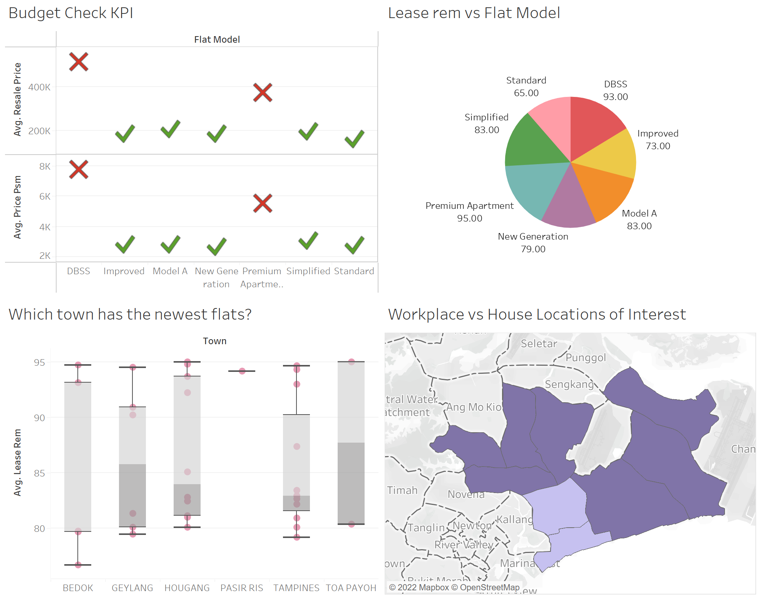
DB 2: finding the “one”

Slide 8
DB 2: finding the “one”
After finding out more about Singapore’s housing market, the couple decided on a 3-bedroom flat in the East/Central region
of singapore.
Now, they just have to decide on the town they wish to live in
and the model of the flat, based on their requirements:
Close proximity to their workplaces (Geylang/Marine Parade).
Flats within their budget of $350,000.
Good number of years remaining in house lease
(>80 years).
Newer flats.
EXPLORING FLAT MODELS WITHIN THE BUDGET VIA KPI
DISTANCE OF FLAT FROM WORKPLACE
2 KPI charts:
(“Resale Price KPI”) checks which flat model in the selected towns fall within the budget of not more than $350,000.
(“Price Psm KPI”) checks which flat models fall within the budget of not more than $4,000.
Parameter chart:
(“Resale Budget Threshold”) allows me to place a constant maximum value of $350,000, to aid in (“Resale Price KPI”)
From the KPI charts, the flat models (Improved, Model A, New Generation, Simplified and Standard) fall within the budget.
The filled map clearly shows the location of their workplaces (light purple regions) and the locations of their interests where they would like to live in (dark purple regions).
With that, the couple has easily narrowed down to a few choices in the East/Central regions of Singapore!

Slide 9
DB 2: finding the “one”
Lease rem vs flat model
WHich town has newer flats?
The pie chart shows the median number of years remaining in the lease for different flat models.
The flat model with the largest number of years left in the lease is Premium Apartment (95), while the smallest is Standard Flats (65).
Other flat models with more than 80 years remaining are Model A (83), Simplified (83) and DBSS (93).
The box plot shows that Pasir Ris has newer flats as it has a median of 94 years remaining in the lease, followed by Toa Payoh 84 years. Bedok has the lowest median of 79 years remaining in the lease.

Slide 10
Summary of my analysis
After seeing the second dashboard, the couple now has a better understanding of which flat models and locations fit their requirements. They have asked for my insights and recommendations to further aid in their decision-making.
What I have learnt:
I have learnt how to visualize data using different graphs, KPI and parameter charts.
I have also learnt that I research about my dataset to have a deeper understanding of the data.
HOW I CLEANSE THE DATA:
I cleansed my data by removing columns that I did not use.
My insights/recommendations:
I would recommend them to choose the flat model (Model A). Despite Premium Apartments and DBSS having a greater number of years remaining in the lease, they are not within their budget.
Not only are Model A flats within their budget, these flats also have a good number of years left in the lease (>80). Furthemore, they have 2 separate levels (3 Bedrooms & 3 Bathrooms), providing plenty of space their dog to run around.
I would also recommend buying a flat at Hougang or Toa Payoh as they have newer flats as compared to other towns, and are also reasonably close to their workplaces.
At last, they have decided to buy a 3-Bedroom, Model A flat in Toa Payoh…

